Slide 1
Personality Based Chatbot
Sukeerthi Varadarajan

Slide 2
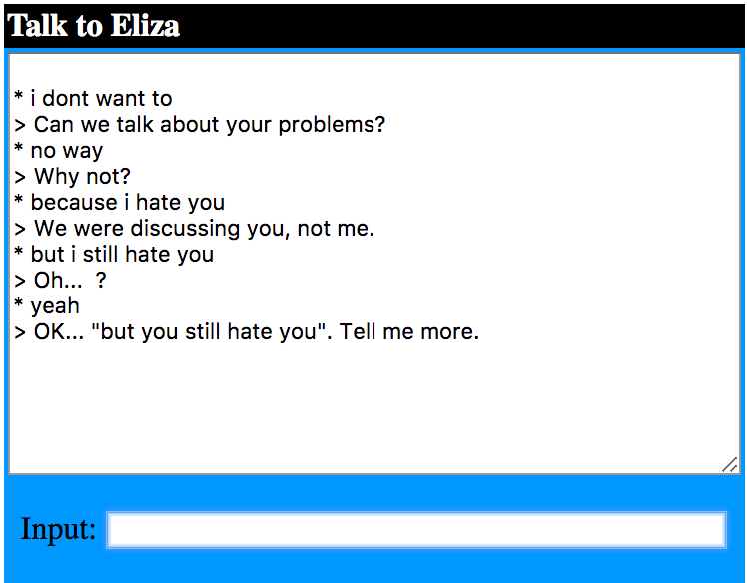
Chatbots-
Lack personality
Fixed set of responses

Slide 3
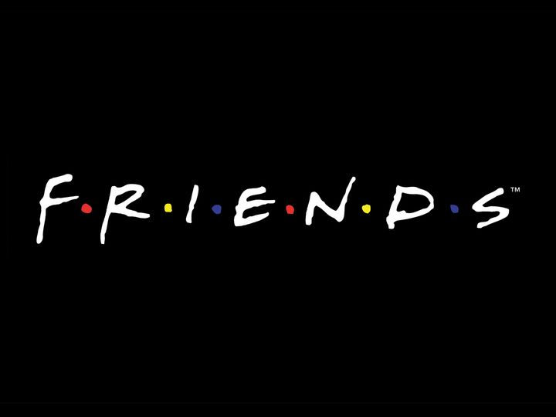
Personality Based Chatbot
Responds to user input by mimicking a popular personality from a popular TV series

Slide 4
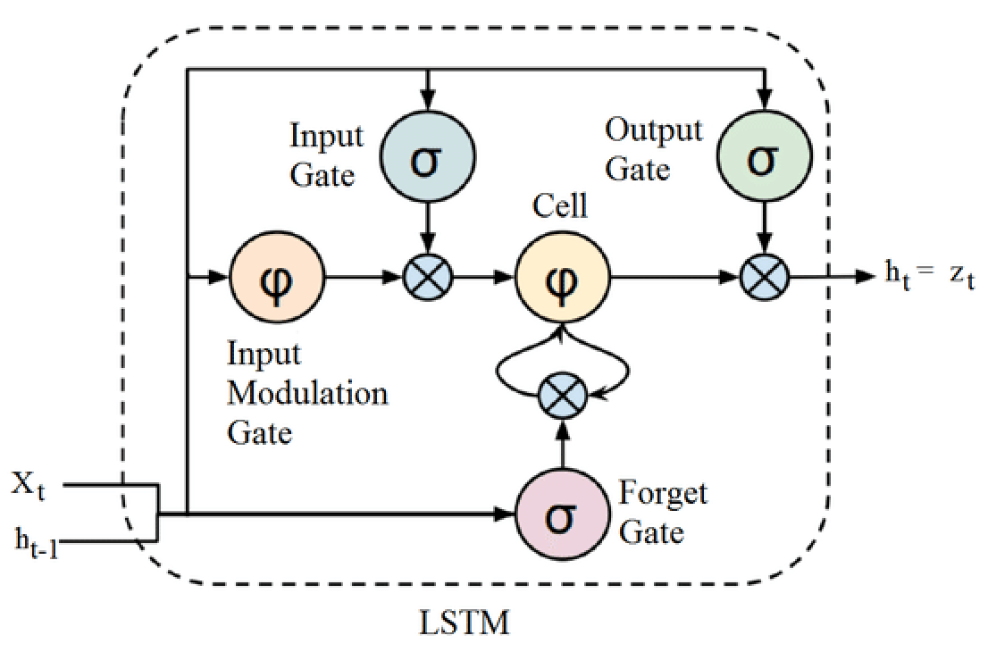
Long Short Term Memory (LSTM) Networks
Recurrent Neural Network
Understands dependencies
Gates
Applications-
Text, Handwriting Generation
Speech Recognition
Language Translation
Image Captioning

Slide 5
Methodology
Data
BeautifulSoup
F.R.I.E.N.D.S. TV Series
Preprocessing
Phrases
Vectorization
Model
LSTM RNN
3 Layer
Predict alphanumeric character

Slide 6
Script Generator
Ross: What? No! No! I’m not gonna call you a problem. Well there was no big than a little pasters
Rachel: Hey!
Ross: Okay so you have to go to the big deal
Joey: Hey! Hi, I don’t know what I said that I said that I think it’s my way
Rachel: You don’t have to see if I was coming in there
Ross: What? No! No! I’m not go

Slide 7
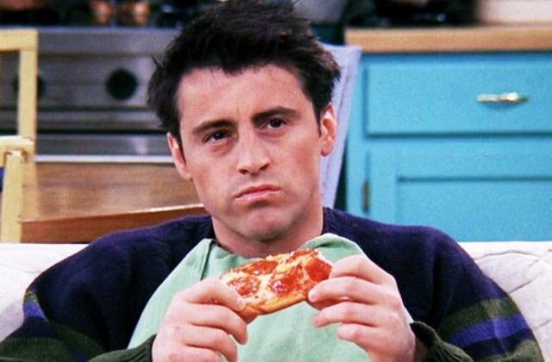
Joey Bot
Trained on Joey’s dialogues

Slide 8
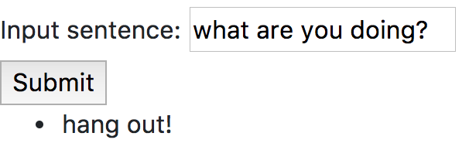
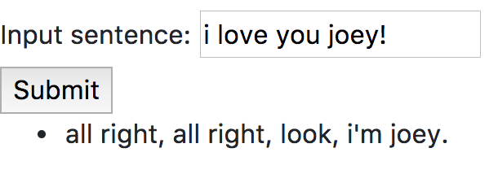
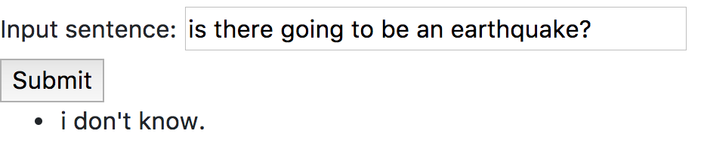
Joey Bot

Slide 9
Conclusion
Achieved
Coherent sentences
Completion of words
Correct usage of punctuation
Next Steps
Word prediction
Grasp context
Add attention
Applications
Script writing tool
Mimic professionals-
Psychologists
Salesmen

Slide 10

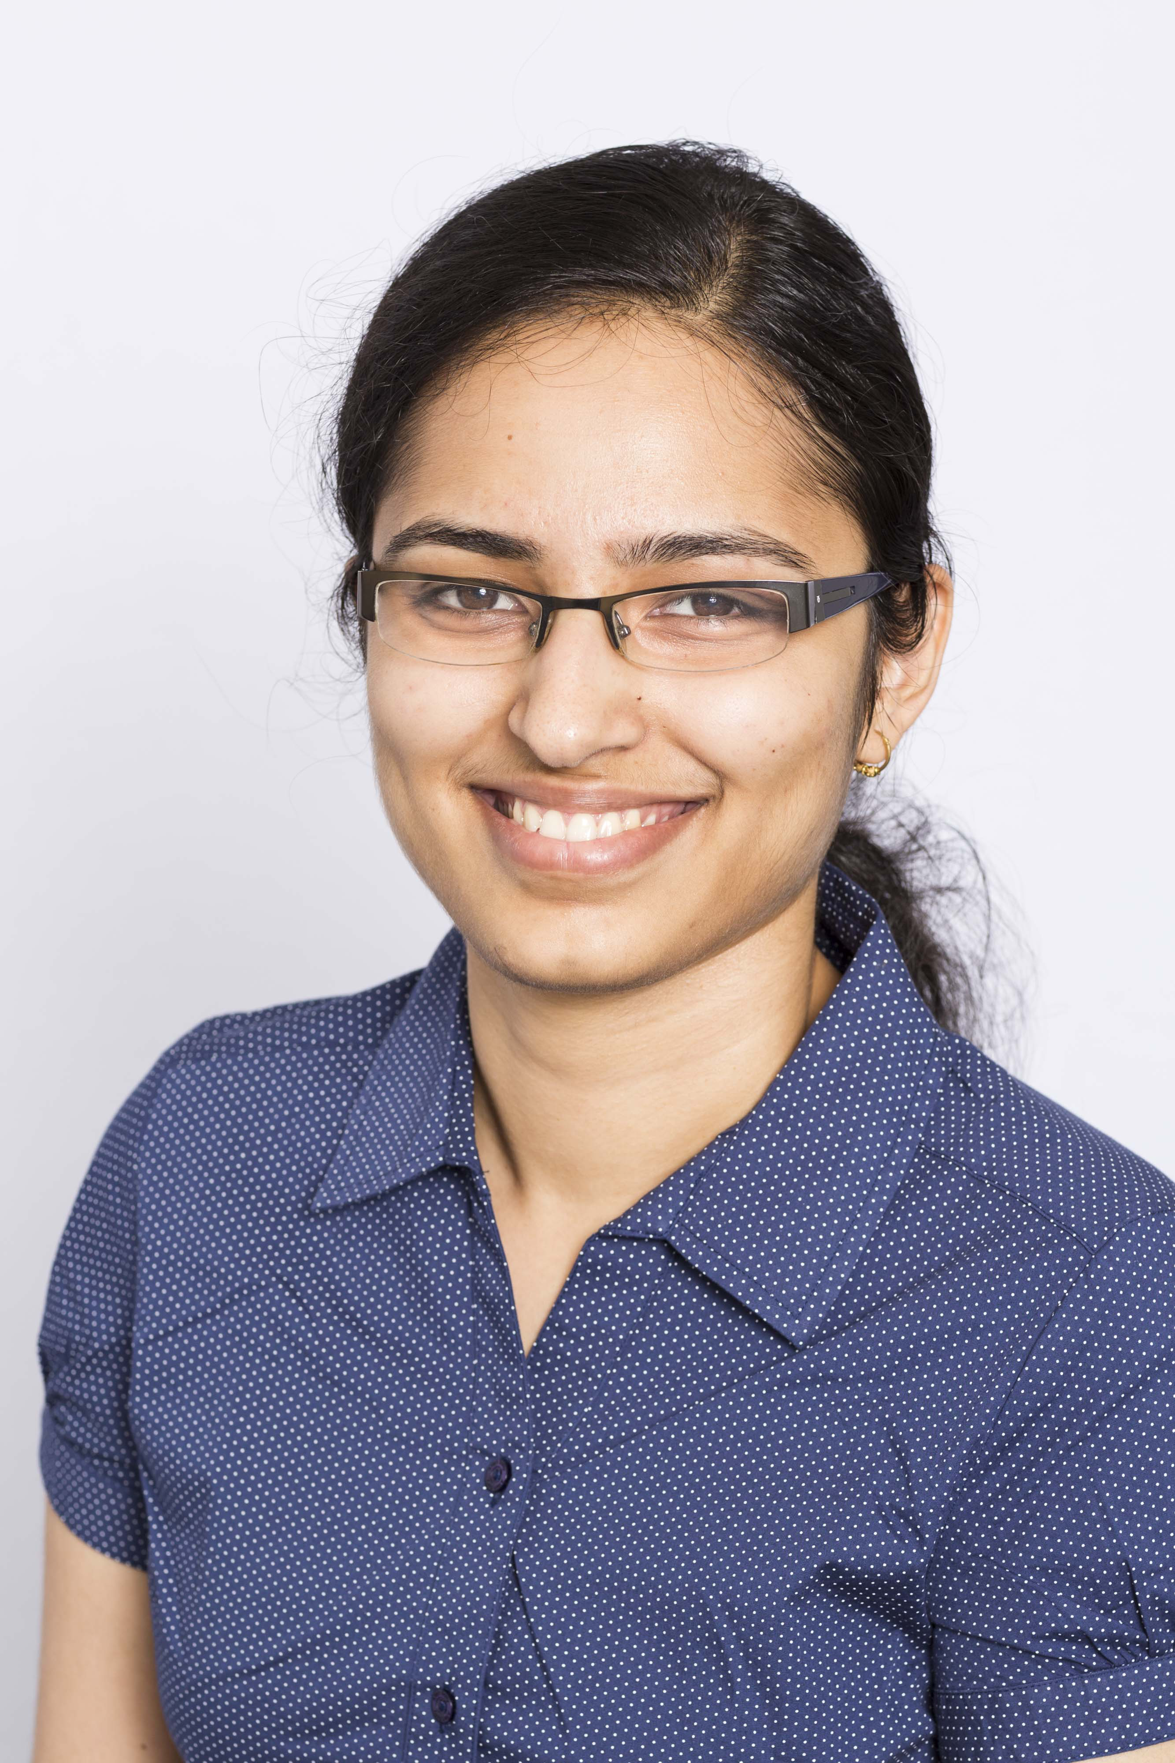






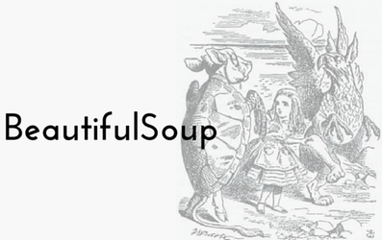
Thank you!
v.sukeerthi@gmail.com
sukeerthi-varadarajan
suki2691

